Slide 1
FORCES ON SUBMERGED PLANE SURFACES
Gates

Slide 3
consider the general case of a plane submerged area AB, such as that of Fig. located in any inclined plane X-X.

Slide 4
Let the center of gravity of this area be located as shown, at a depth h_{g} and at a distance l_{g} from the line of intersection, 0-0

Slide 5
indicating that the magnitude of the resultant force on a submerged plane area may be calculated by multiplying the area,, by the pressure at its center of gravity,
Its direction, is normal to the plane
its point of application may be found if the moment of the force can be calculated and divided by the magnitude of the force.

Slide 7
The above equation may be made more usable by placing it in terms of the moment of inertia, I_{g}, about an axis parallel to 0-0 through the center of gravity of the area.
Using the equation for transferring moment of inertia of an area from one axis to another

Slide 10
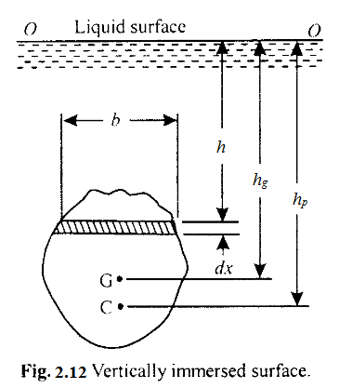
vertical plane surfaces

Slide 11
Example. A heavy car plunges into a lake during an accident and lands at the bottom of the lake on its wheels. The door is 1.2 m high and 1 m wide, and the top edge of the door is 8 m below the free surface of the water. Determine the hydrostatic force on the door and the location of the pressure center, and discuss if the driver can open the door.

Slide 12
Discussion
A strong person can lift 100 kg, whose weight is 981 N or about 1 kN.
Also, the person can apply the force at a point farthest from the hinges 1 m farther
So maximum generate a moment is 1 kN · m.
The resultant hydrostatic force acts under the midpoint of the door, and thus a distance of 0.5 m from the hinges. This generates a moment of 50.6 kN · m

